Slide 1
Programming in Data Science Presentation
Python Pioneers: Shivam Ahuja, Kathleena Inchoco, Ryan Drost, Isha Slavin

Slide 2
Outline
Problem Statement
01
What insights can we get from 311 complaints to understand housing trends and rent in NYC?
02
Methodology and Analysis
Understanding 311 Complaints
Understanding 311 Complaints and Rental Price
Key Findings and the Future
03
Results from our analysis
Future analysis and Next steps

Slide 3
The Problem
Situation
There is a wealth of publicly available data on housing in New York City through NYC Open Data and StreetEasy, even though housing continues to be a problem for many New Yorkers.
Complication
Rent is not available in the 311 dataset and for mapping we would need to merge it with the Streeteasy dataset which provides median rent for each month at a neighborhood level
SCQA
Question
Incidence of complaints differ across borough?
Was there any difference in complaints during covid vs pre covid?
Correlation between rent and complaints?
Answer
Understand if we there is a relation between rent and number of complaints and Provide a visual resource to better understand complaints and price trends in the city.

Slide 4
Methodology
1
2
3
4
5
311 Dataset Cleaning
Merge with other datasets
Exploratory Analysis
Visualizations
Machine Learning
Looked into top complaints
Looked into top complaints with the highest increase from pre covid (Mar’19-Mar’20) to covid period (Mar’20-Mar’21)
Neighborhoods with least and most rent
Visualized complaints and neighborhoods by rents on bar charts
Visualized top complaints by neighborhood on the NYC map using geopandas
Visualized complaints and rents trends using timeseries analysis
Visualize zips on a scatterplot of complaints vs rent
Created a logistic regression model to predict high vs low rent based off number of complaints
Created a logistic regression model to predict borough by number and type of complaints and seasonality
Download the 311 dataset from the NYC open data website
Cleaned the data to include only relevant Zips
Cleaned the zip codes to only have zips in 5-digit format
Created a function for mapping the neighborhoods to the relevant ZIP code
Merge the Streeteasy dataset with the complaints dataset to get median rent by month and year

Slide 5
The Analysis
Part 1: Understanding 311 Complaints
Does the incidence of 311 complaints differ across boroughs in NYC?
Did the incidence of 311 complaints change from before and during the pandemic?
Is there seasonality in the incidence of specific complaints?
Part 2: Understanding 311 Complaints and Rental Price
Is there correlation between number of complaints and rent by borough?
How did rent and complaints change from before and during the pandemic?

Slide 6
Snapshot of our data
10M+
300+
170+
Noise
Total 10 million rows of data for complaints by ZIP code
The dataset had 300+ different types of complaints recorded from 2018-22
177 unique zipcodes covered in the dataset across the 4 years
Most common complaint across the 4 years in our dataset

Slide 7
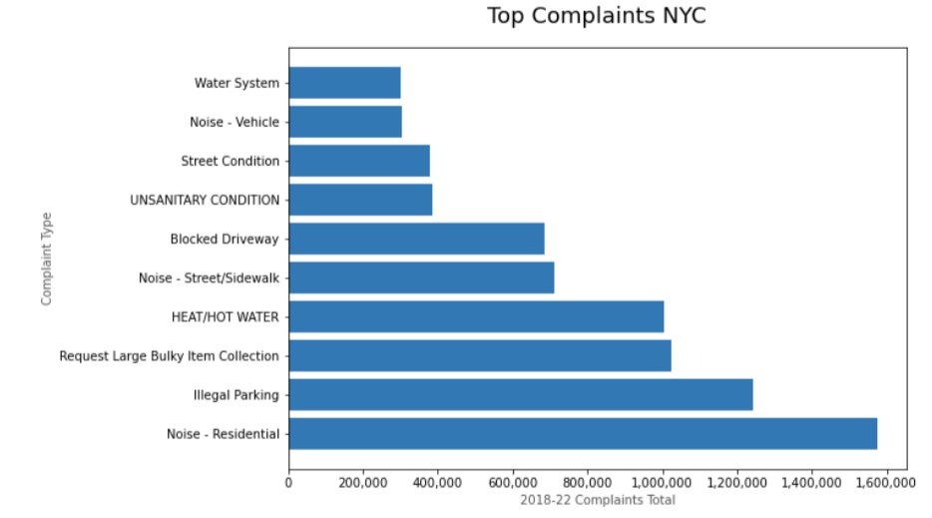
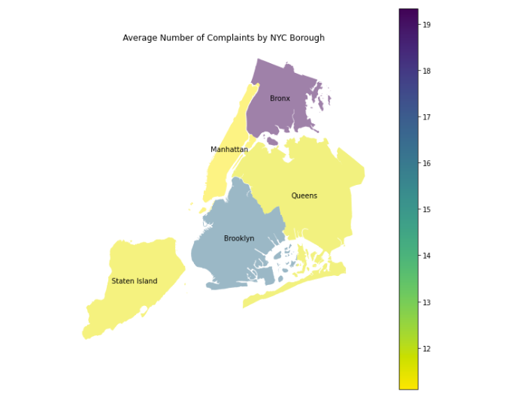
Initial Exploratory Analysis
Top Complaints in New York City from 2018-22
Average Complaints in New York City by Borough

Slide 8
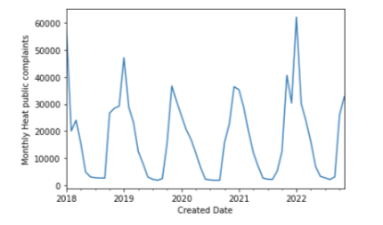
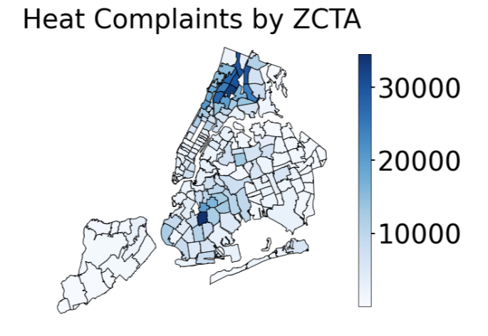
Visualizing some top complaints - Heat
Time series trend for Complaint - Heat
Visualizing complaint volume by neighborhood - Heat
From the time series analysis, we can see that heat complaints are really seasonal and also are mostly coming from either Bronx or Brooklyn. Thus, 311 team could better prepare for these by focusing their resources pre hand in these areas during this time of the year.

Slide 9
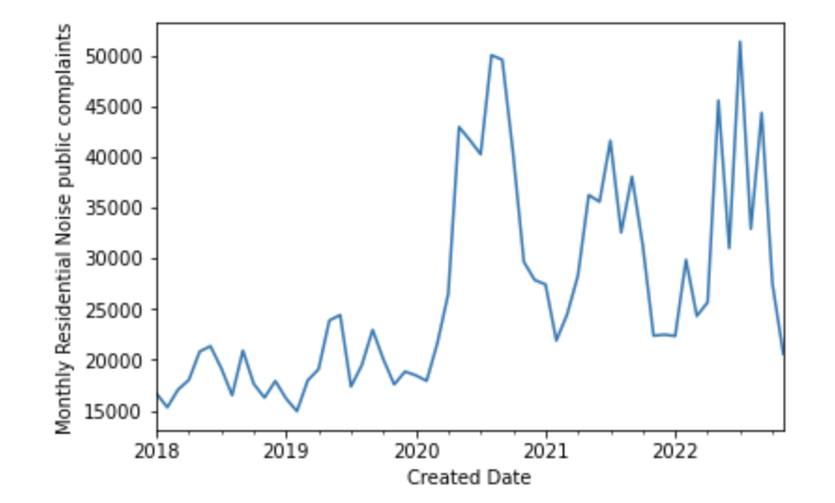
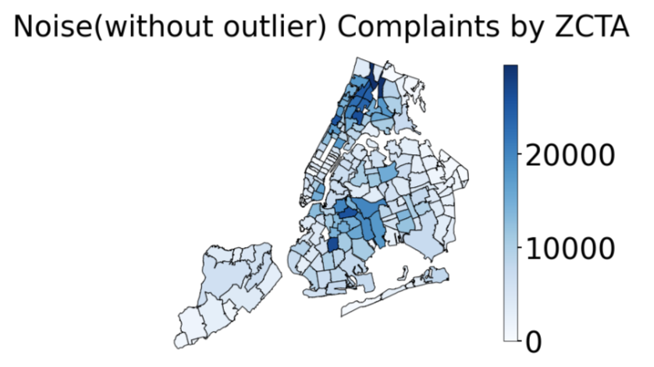
Visualizing some top complaints - Noise
Time series trend for Complaint – Noise Residential
Visualizing complaint volume by neighborhood - Noise
Residential Noise complaints took a sharp increase during the period of lockdown and was mostly concentrated in Bronx and Brooklyn.

Slide 10
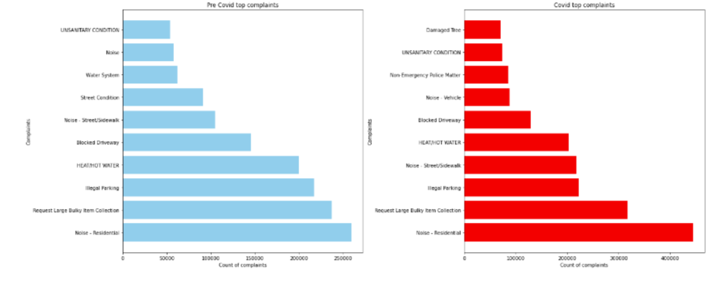
Were the top complaints different for pre covid (Mar’19-Mar’20) vs covid (Mar’20-Mar’21)?
Top Complaints in New York City – Pre Covid vs Post Covid
In terms of volume, there was not much difference across the types of complaints that we had during pre covid vs post covid

Slide 11
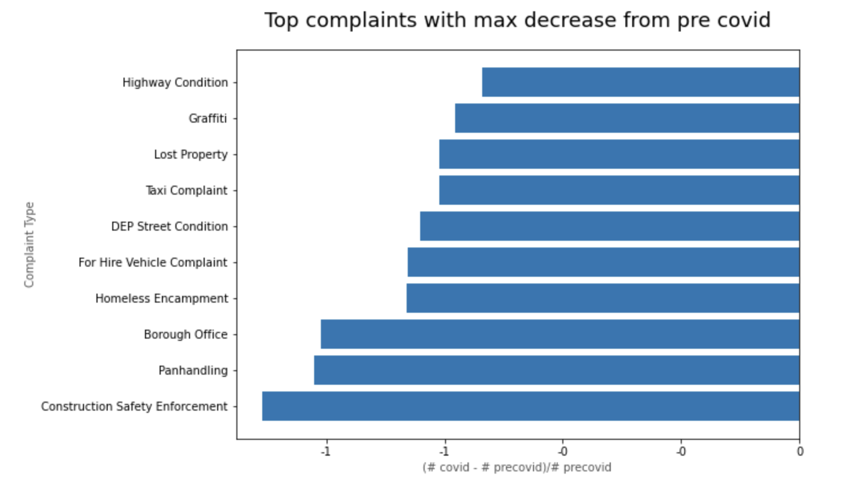
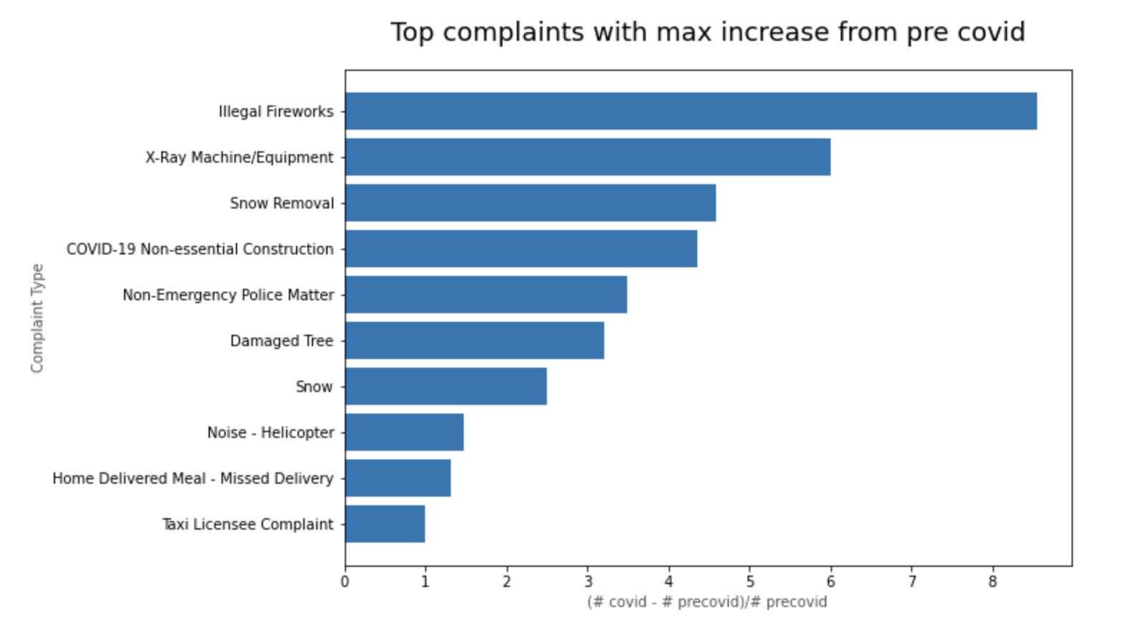
Which were the complaints with the max increase and decrease during covid compared to pre covid times?
Complaints with maximum relative increase
Complaints with maximum relative decrease
We noticed a huge decrease in complaints which involved people going outside like highway condition, Graffiti, Panhandling while there was an increase in complaints around illegal fireworks, COVID-19 non-essential work and Missed delivery of home meal which aligns with what was observed during the COVID period

Slide 12
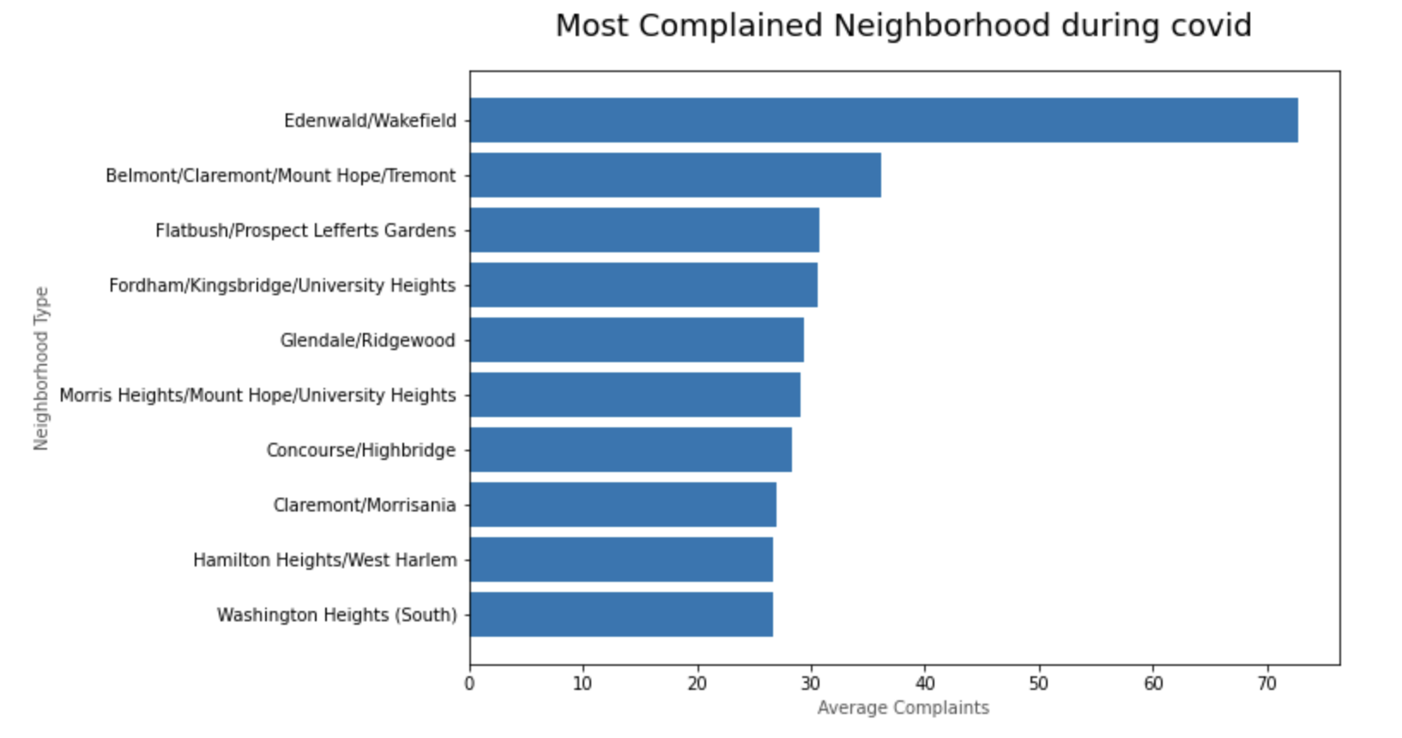
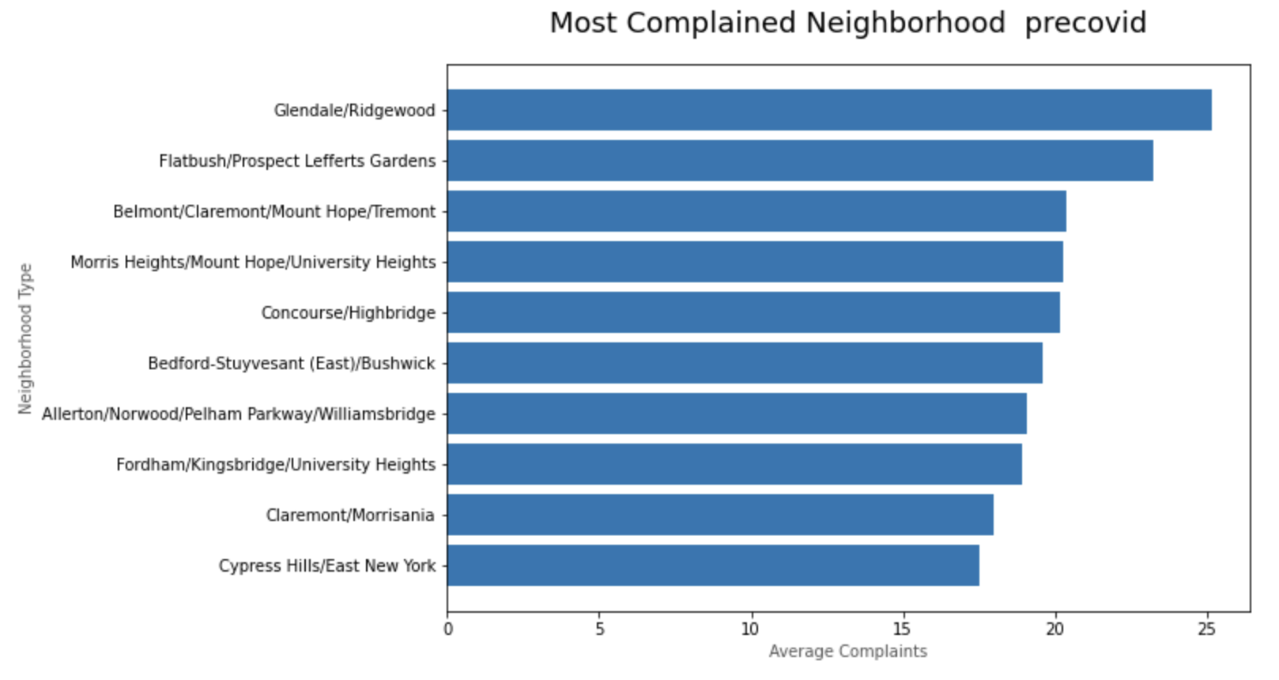
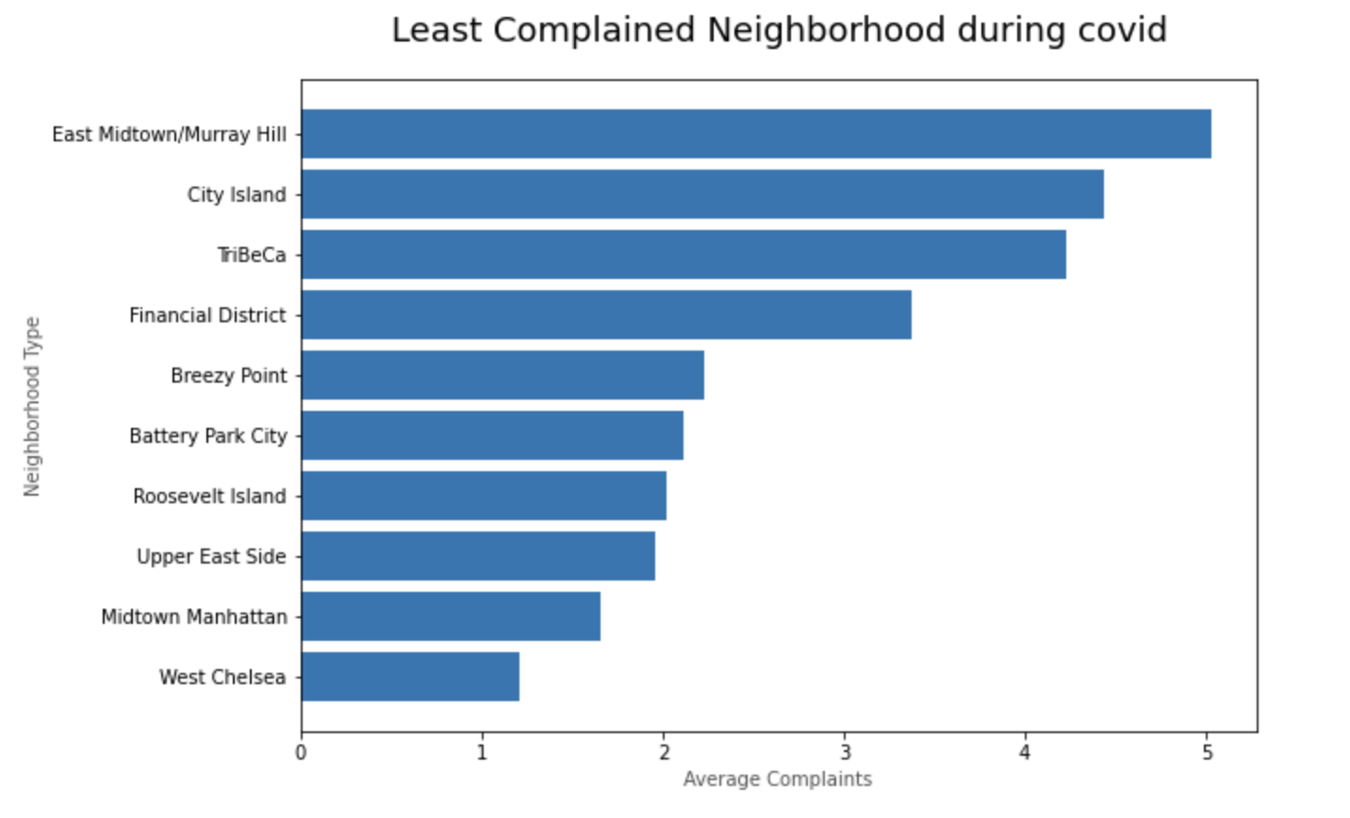
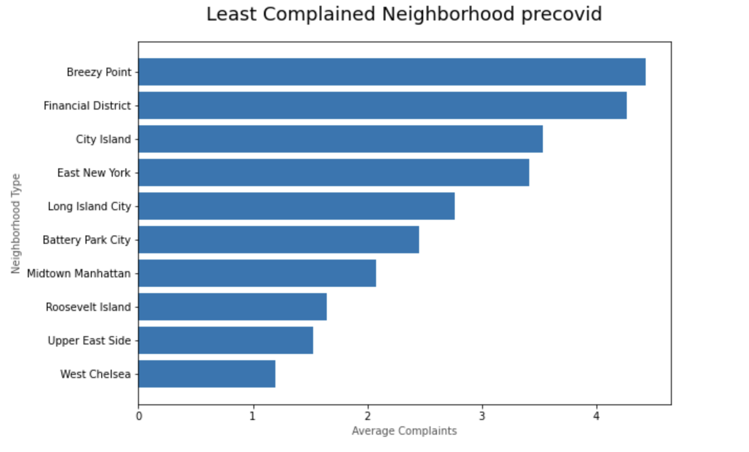
Were the complaints from similar neighborhoods or did the area of complaints change in covid?
Most Complained - Covid
Most Complained – Pre Covid
Least complained - Covid
Least complained – Pre Covid
Similar neighborhoods in both categories implying COVID 19 did not have an impact in terms of the number of complaints coming from a particular neighborhood.

Slide 13
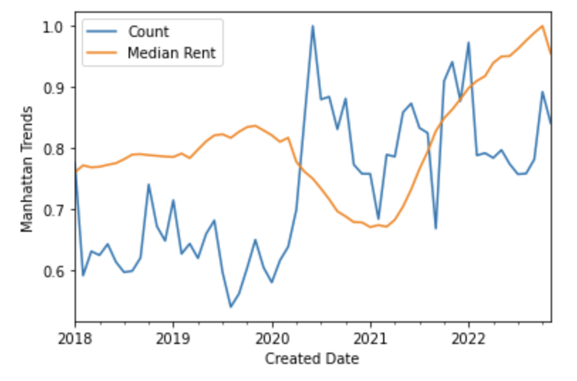
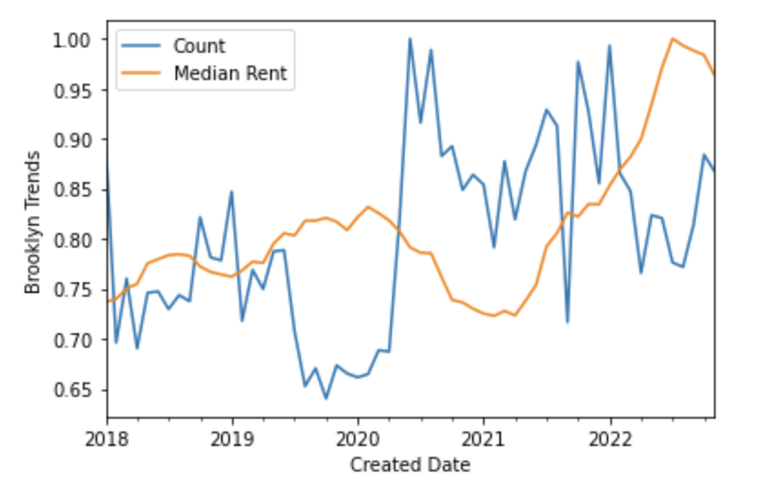
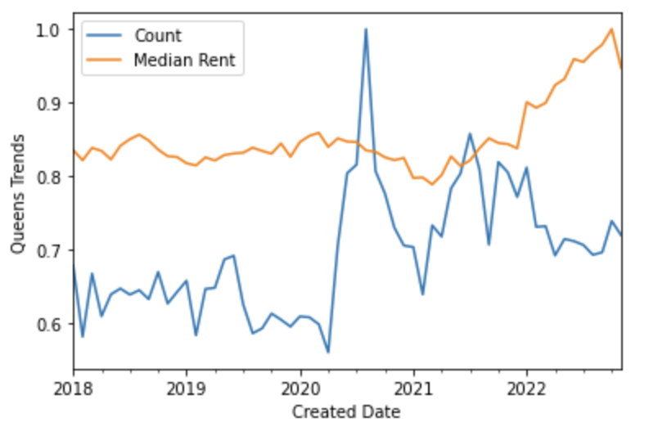
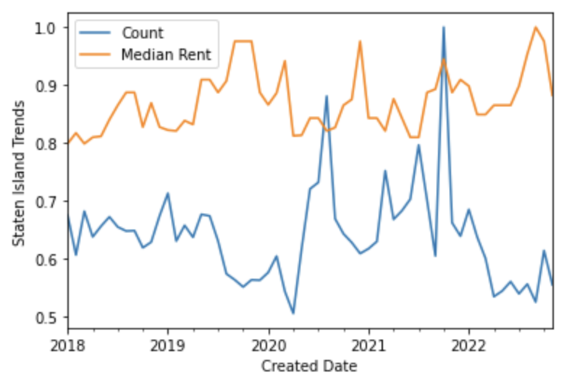
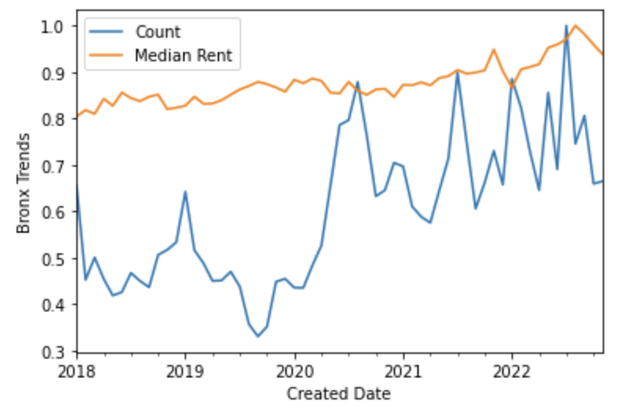
How was rent affected during covid?
Manhattan
Brooklyn
Queens
Staten Island
Bronx
Both Manhattan and Brooklyn noticed a huge drop in rents during the covid period whereas the other boroughs pretty much remain settled around the same price range. We also notice the decline in price in Manhattan and Brooklyn coincided with an increase in the complaints too.

Slide 14
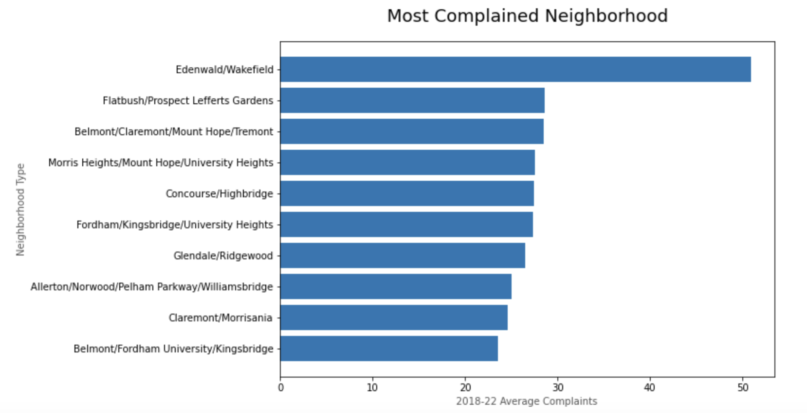
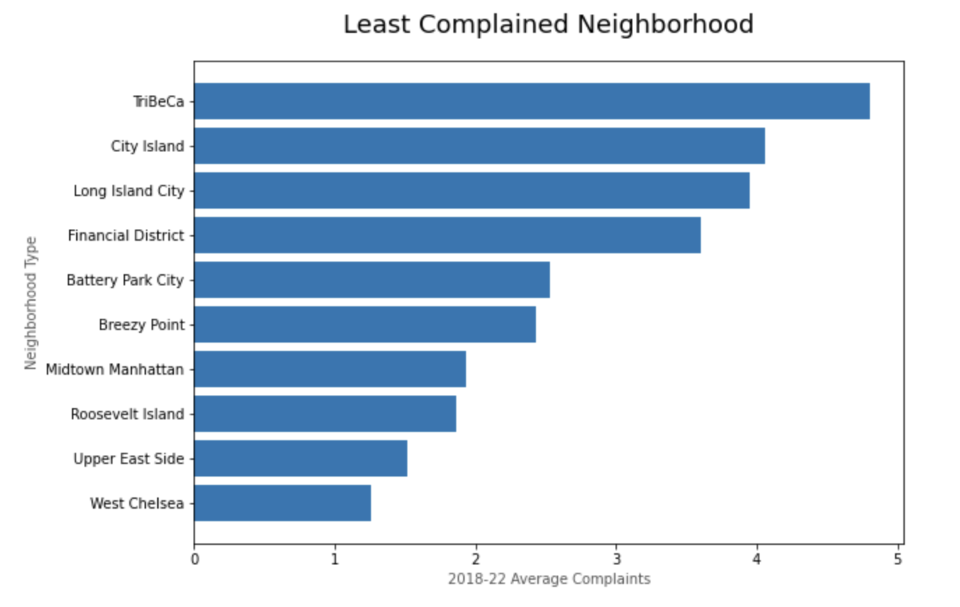
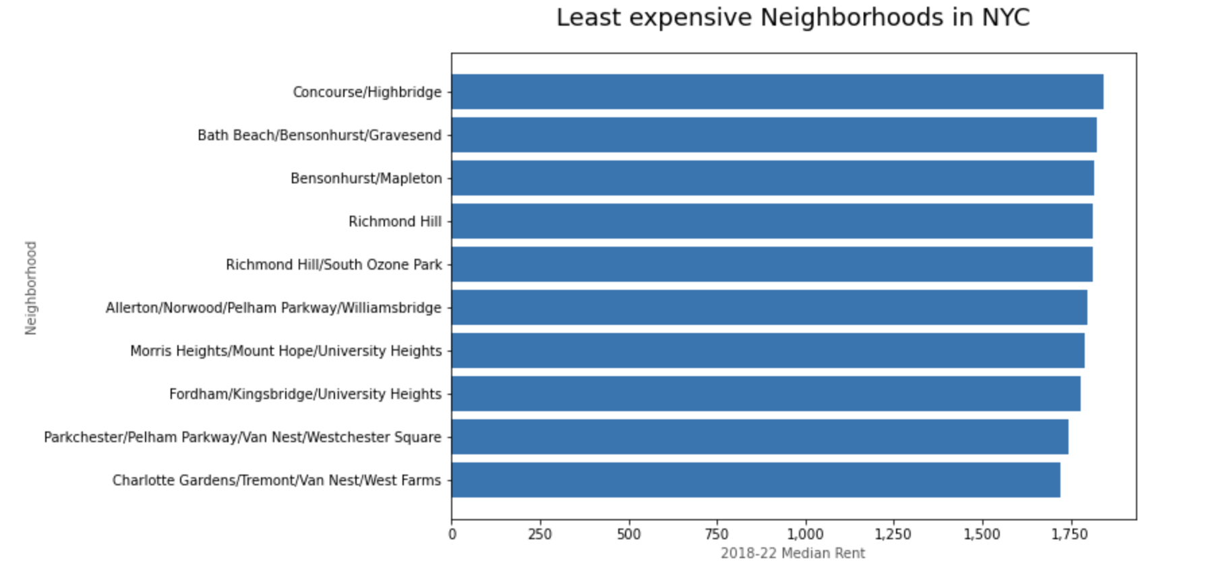
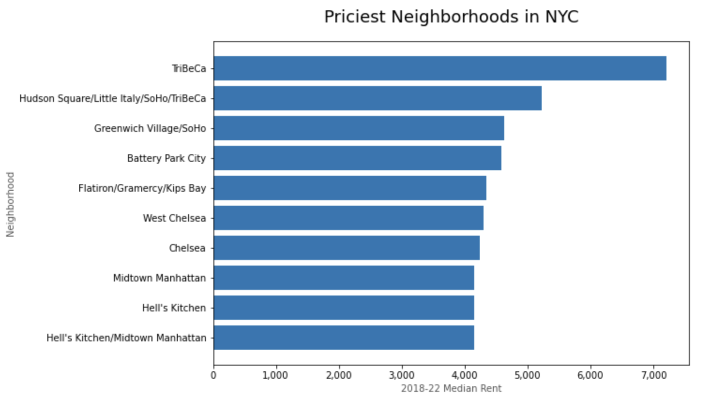
Was the correlation just because of covid or in general?
Most Complained Neighborhoods
Least Complained Neighborhoods
Least Expensive Neighborhoods
Most Expensive Neighborhoods
There is overlap in neighborhoods who have high complaints and low rent and vice versa indicating there is correlation between median rent and number of complaints.

Slide 15
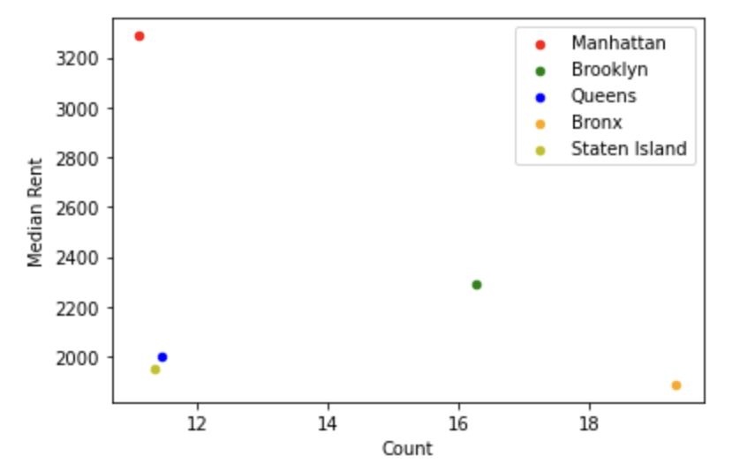
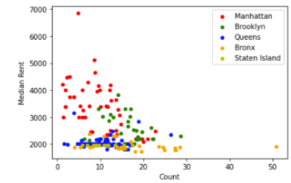
Was the correlation just because of covid or in general?
Rent vs Complaints scatter - Borough
Pearson Correlation Coefficient
On running a correlation between median rent and number of complaints at a neighborhood level, we notice a correlation of -0.242 with a p-value of 0.00099 which is significantly less than the threshold of 0.005 indicating that rent is correlated to number of complaints, and we could use that to predict whether a neighborhood would have a high rent vs low rent.
Rent vs Complaints scatter - Borough
Given the decent correlation, we try to build a logistic regression model for predicting high vs low rent by using information around number of complaints from a neighborhood

Slide 16
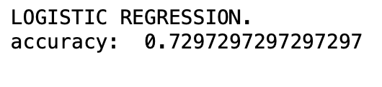
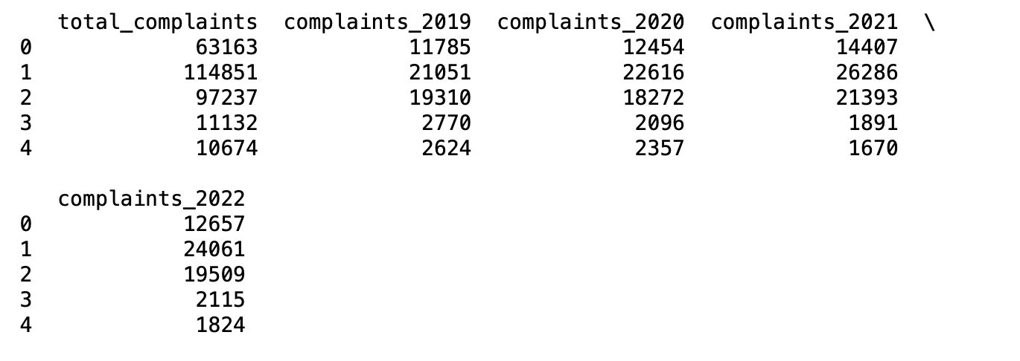
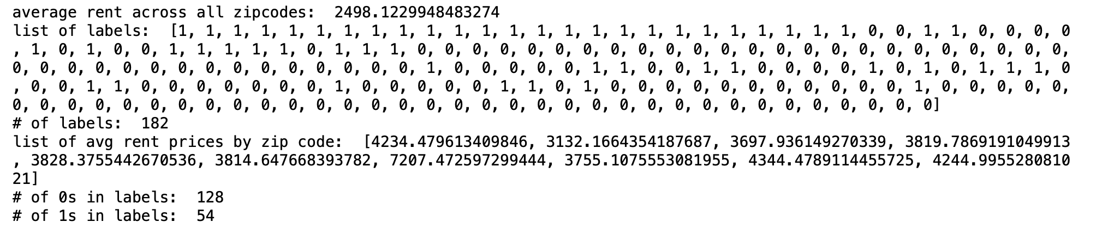
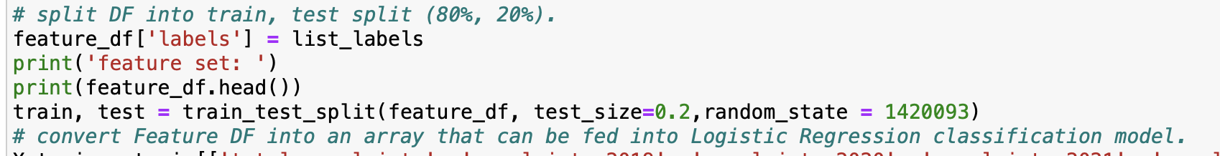
Predicting high vs low rent using complaints at a zipcode level
Feature Generation
Label the zipcodes as high rent vs low rent
Test Train Split
Accuracy
Split the dataset into test vs Train. Test dataset will be used for checking prediction accuracy and train dataset will be used for building the model
Check the accuracy of our model
Screenshot 2022-12-11 at 6.39.53 PM
Calculated complaints count by neighborhood by year
Labelled each ZIP as high vs low rent by comparing it against the average:
We are able to predict whether a zipcode has high rent vs low rent with 73% accuracy based off the number of complaints received in that zipcode in the past 4 years.

Slide 17
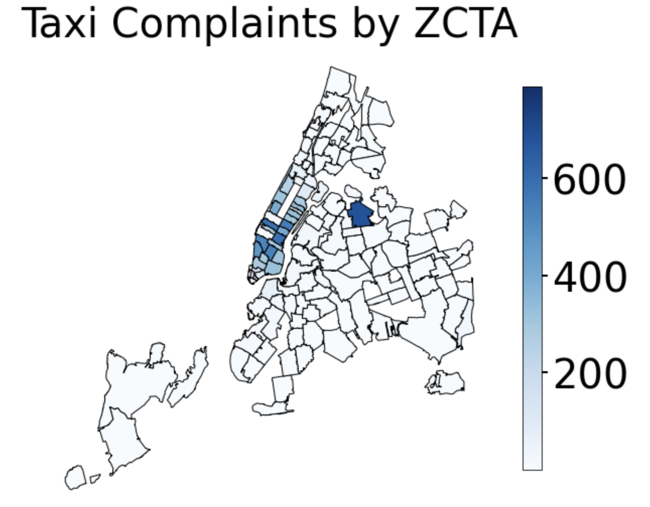
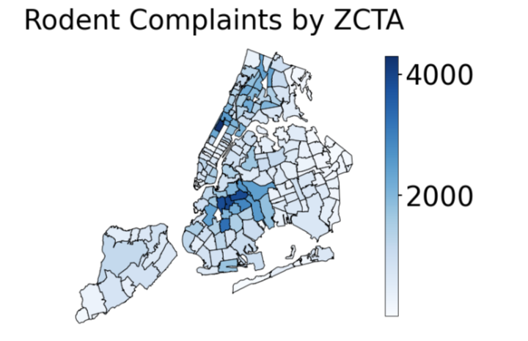
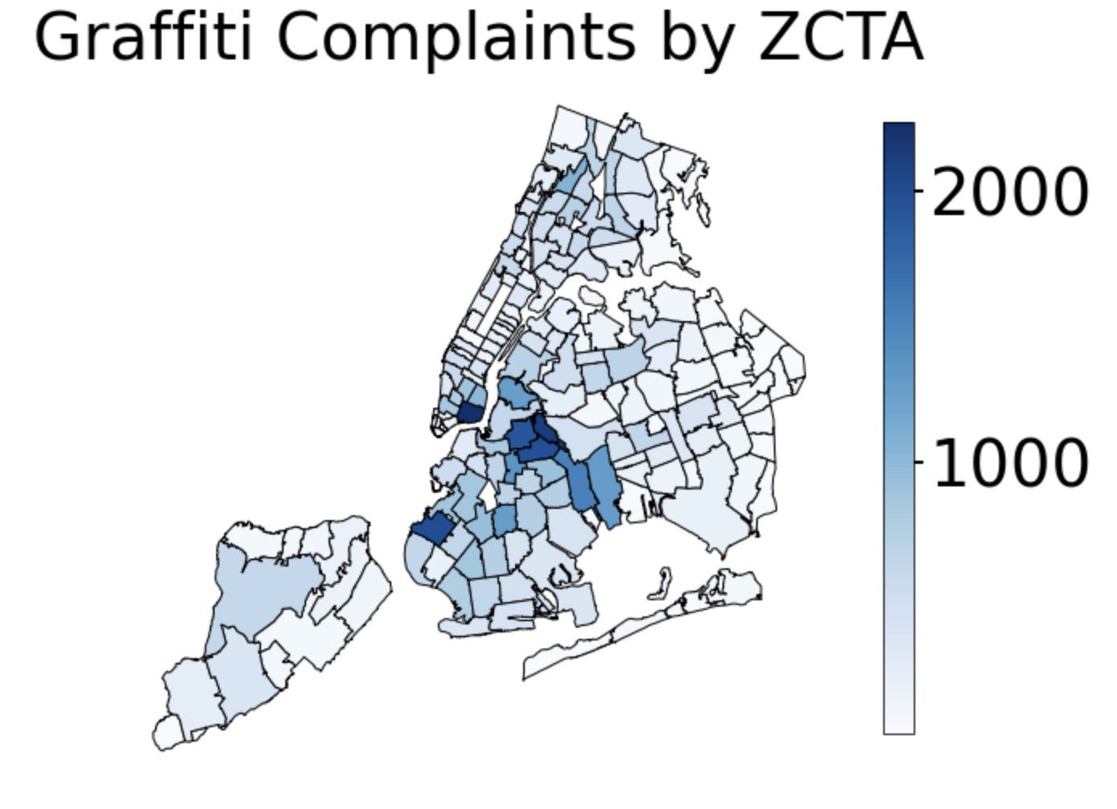
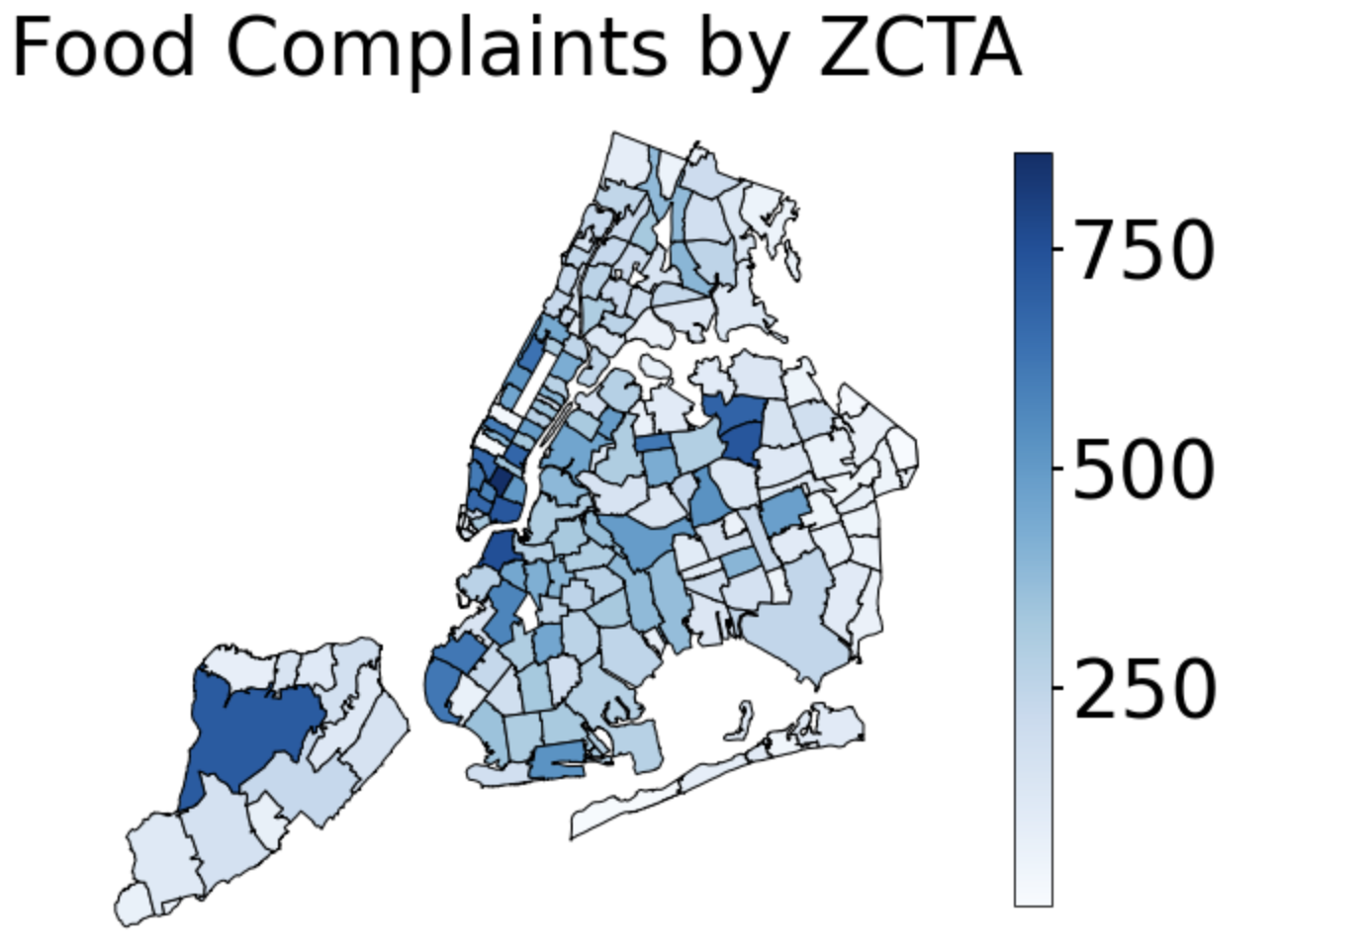
Visualizing some common complaints on the map to see if there is a trend by neighborhood and which potential complaints we could use for prediction
Taxi Complaints
Mostly concentrated around Manhattan and Laguardia airport
Rodent Complaints
Mostly concentrated around parks (Central park upper west and Prospect park)
Graffiti Complaints
Mostly concentrated around Chinatown or Brooklyn
Food establishment Complaints
Mostly concentrated around Chinatown and staten island
From the above , we can clearly see that there are trends around location based off complaint type and thus, this could be used to predict the complaint type based off the neighborhood data

Slide 18
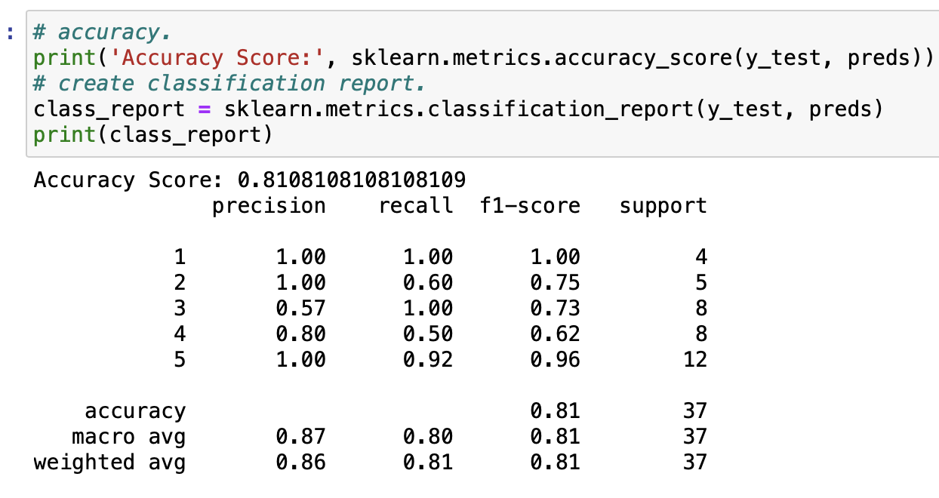
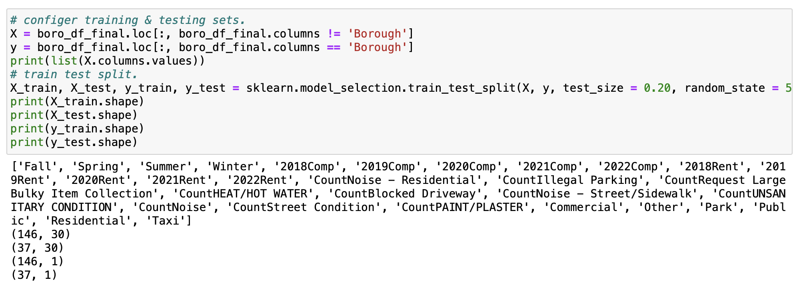
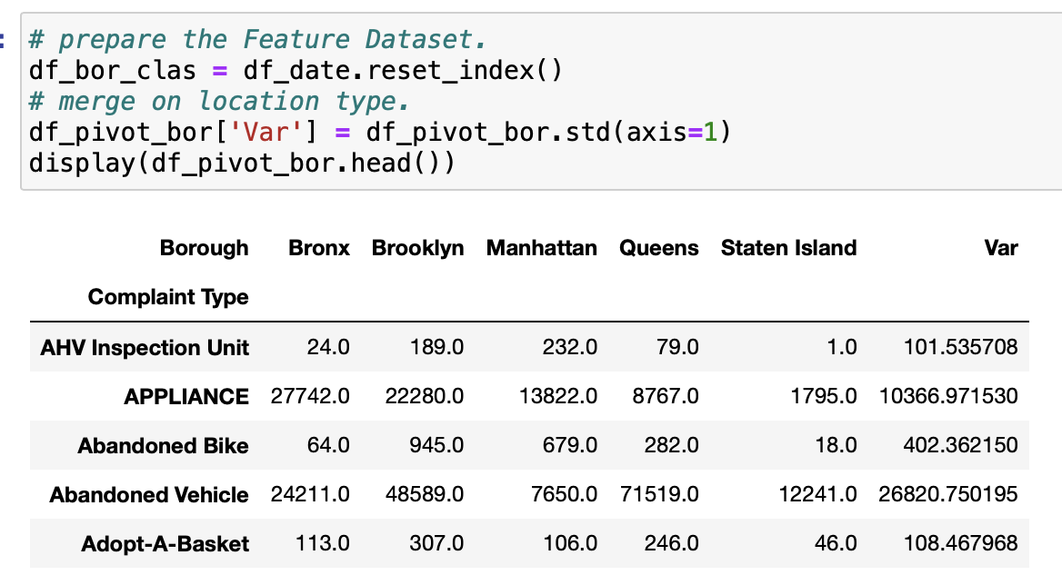
Also Given the differences in borough by rent and complaints, can we predict the borough by a logistic regression model
Feature Generation
Test Train Split
Accuracy
Screenshot 2022-12-11 at 6.39.53 PM
Split the dataset into test vs Train. Test dataset will be used for checking prediction accuracy and train dataset will be used for building the model
Checking our model’s performance by looking at key prediction metrics on test vs train data:
Calculate complaints by season,year at a zipcode level
Identify complaints which are different across boroughs to find complaint types which could help in our modelling
Staten Island
Bronx
Queens
Brooklyn
Manhattan
We are able to achieve a 81% accuracy to predict boroughs using our generated features around complaint numbers by season, types and year at a specific zipcode level. We do however face some issues at a borough level in precision and recall. We are good at identifying all relevant queens cases but not all predicted queens are actually queens. And the opposite is true for Brooklyn and Bronx.

Slide 19
Future Analysis
01
Identifying zipcodes by the type of complaint.
Creating an online tool where the user can select the complaint type and see summaries and visualizations so that they can take an informed decision
02
Predicting certain complaints timings based off seasonality and other features to help the 311 team tackle the complaints better
03

Slide 20
Questions & Answers
Open to any questions the team might have around the dataset or the approach?
The approach and final result are still preliminary and might change based off further data exploration

